Slide 1


Project 4 – Machine Learning
Monash Bootcamp
Deepa Nair, Denise Demirkol, Kevin McConchie,
Kinlay Denning, Jeya Emmanuel, Radhika Alapati

Slide 2
Agenda / Topics
Project Motivation
Project Objective
Project Methodology
Key Findings/Results
Research drilldown
Conclusion

Slide 3

Motivation
Telecommunication Technology plays a major role in today’s world as almost everyone uses this technology in one way or the other. Telecom companies are competing in an increasingly fast-paced, complex, global economy. To succeed, they must navigate a world where customer needs are changing rapidly, where a strong omnichannel strategy is mandatory, and where extensive technology investments—most notably 5G—will be required. Customers when given choices will constantly opt for better options hence it is important for Telecom Companies to provide quality service.
Our project is based on analyzing the data from one telecom company and using Machine Learning to derive meaningful insights.

Slide 4
Project Objective
Finding the % of Churn Customers and customers that keep in with the active services.
Analyzing the data in terms of various features responsible for customer churn
Finding a most suited machine learning model for correct classification of churn and non churn customers
To develop an application to predict whether the customer will churn or not using the explanatory variables

Slide 5
Procedure/Methodology
We have taken the following suggestive steps to build the model
Preprocess data (convert columns to appropriate formats, handle missing values, etc.)
Conduct appropriate exploratory analysis to extract useful insights (whether directly useful for business or for eventual modelling/feature engineering)
Derive new features
Train a variety of models, tune model hyperparameters, etc. (handle class imbalance using appropriate techniques such as Accuracy, Recall, Precision, F1score, F2Score)
Evaluate the models using appropriate evaluation metrics. Note that it is more important to identify churners than the non-churners accurately - choose an appropriate evaluation metric which reflects this business goal
Finally, choose a model based on some evaluation metric

Slide 6
Data Pre-processing – Fulfilling the basic assumptions of modeling
Prediction Outcome Nature - Binary outcome Predicting whether the customer will churn or not.
Supervised Learning is applied as we have a labelled data set.
The Requirements for machine learning models selected based on the prediction outcome
The Response Variable is Binary
There is No Multicollinearity Among Explanatory Variables
The Sample Size is Sufficiently Large (more than 500 data points)
There are No Extreme Outliers

Slide 7
Steps of Processing
Data Imputation
Feature selection is one of the first and important steps while performing any machine learning using heatmaps and box plots. A feature in case of a dataset simply means a column
Pre-process ordinal and nominal categorical variables differently. [label encoder for ordinal and hot encoding for nominal]
Standardization-In Standardization, we transform our values such that the mean of the values is 0 and the standard deviation is 1
Check for Multicollinearity. – we have used VIF

Slide 8
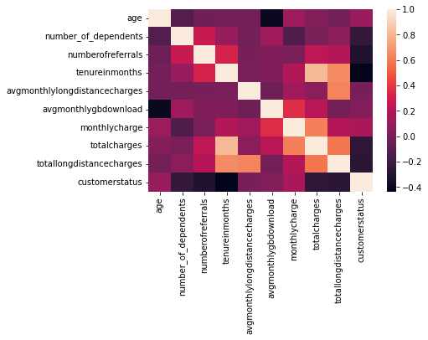
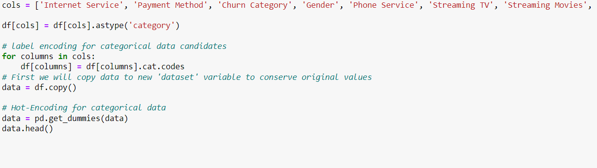
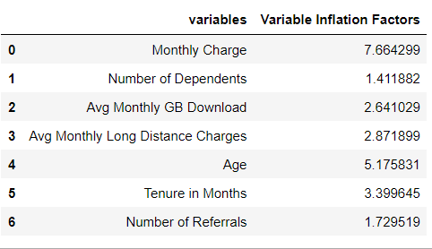
Steps of Processing

Slide 9






Technologies Used

Slide 10
Decision Tree
Radhika Alapati

Slide 11

Decision Trees are a type of Supervised Machine Learning (that is you explain what the input is and what the corresponding output is in the training data) where the data is continuously split according to a certain parameter. The tree can be explained by two entities, namely decision nodes and leaves
Accuracy is the most used evaluation metric; however, it is important that accuracy can be misleading when working with imbalanced datasets

Slide 12
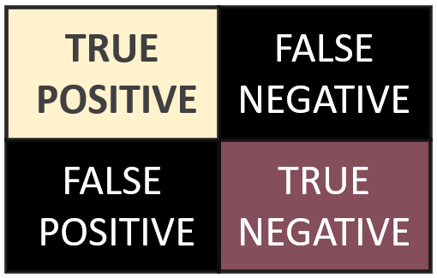
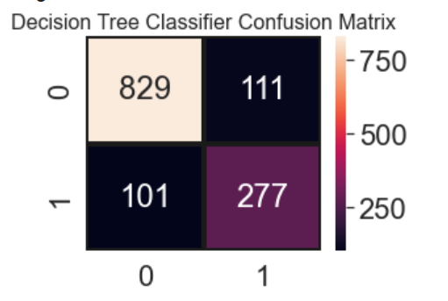
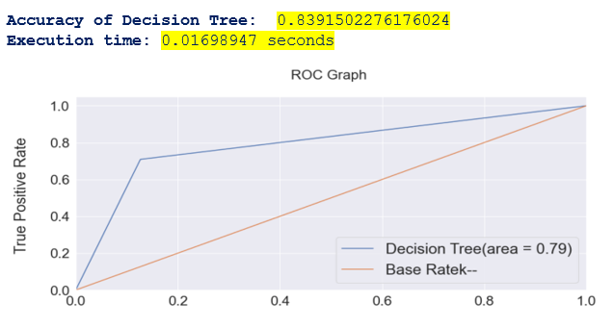

Slide 13
Random Forest
Radhika Alapati

Slide 14
Random Forest Features
The Random Forest classifier contains more decision trees on various subsets of the given dataset. The predictive accuracy of that dataset is improved by taking the prediction from every tree. Bulk prediction votes of every random tree in the forest are processed and the ultimate output is given.
Notes:
Accuracy of Random forest is generally very high
Its efficiency is particularly Notable in Large Data sets
Provides an estimate of important variables in classification
Forests Generated can be saved and reused
Unlike other models It does not overfit with more features

Slide 15
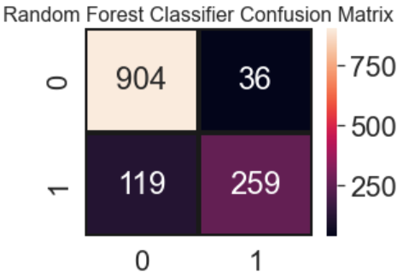

Random Forest Classifier Confusion Matrix

Slide 16
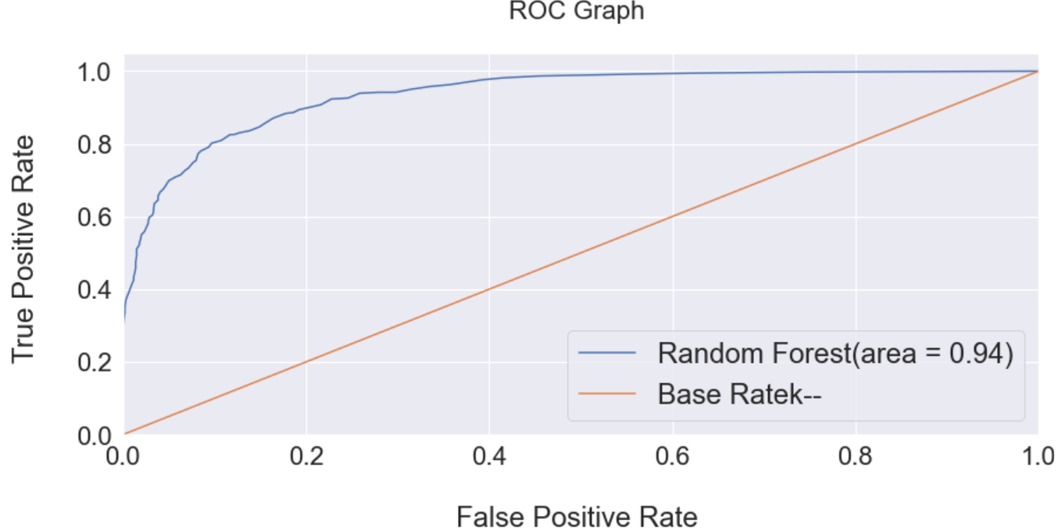
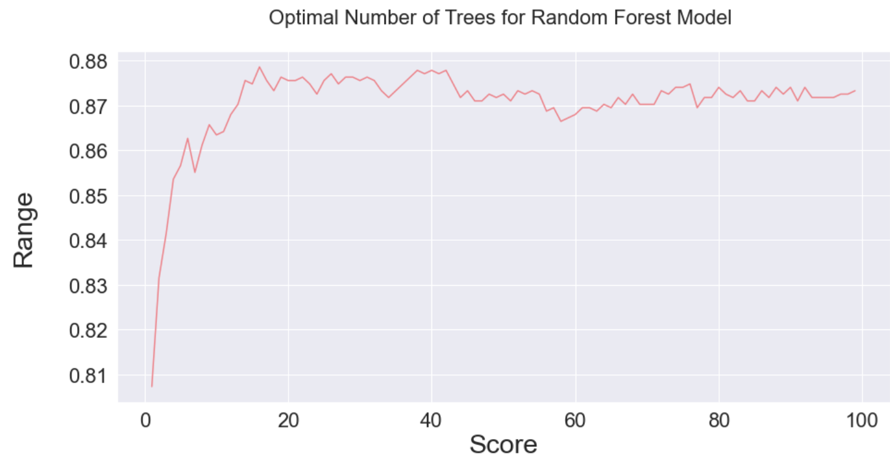
Rates and Scores

Slide 17
Adaboost
Radhika Alapati

Slide 18
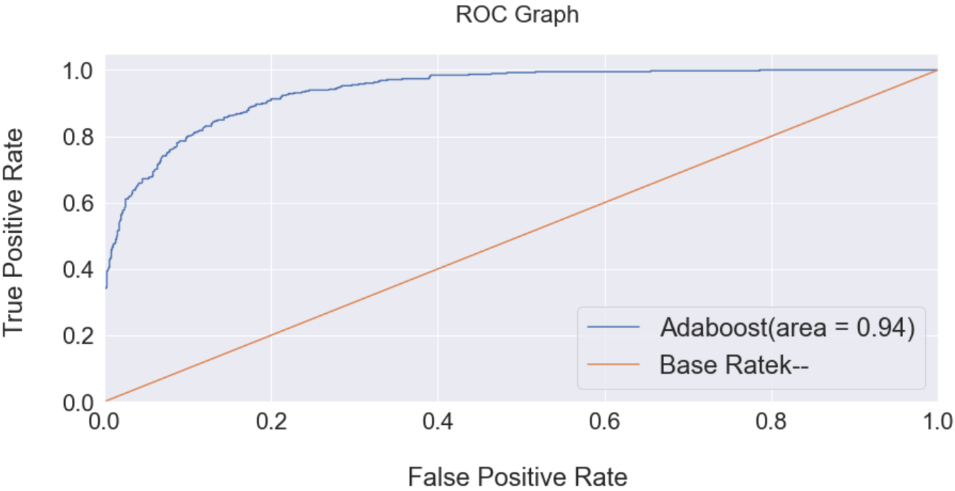
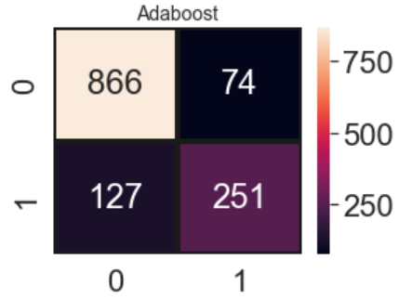
Adaboost Features
AdaBoost is an ensemble learning method (also known as “meta-learning”) which was initially created to increase the efficiency of binary classifiers. AdaBoost uses an iterative approach to learn from the mistakes of weak classifiers, and turn them into strong ones
Notes:
Accuracy of Random forest is generally very high
Its efficiency is particularly Notable in Large Data sets
Provides an estimate of important variables in classification
Forests Generated can be saved and reused
Unlike other models It does not overfit with more features

Slide 19
Logistic Regression
Kevin McConchie

Slide 20
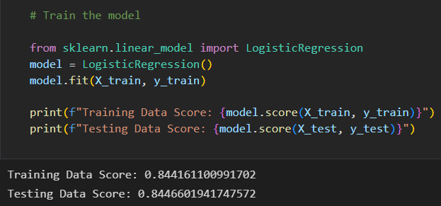
Supporting content
Logistic Regression is used when the dependent variable(target) is categorical. For example, To predict whether an email is spam (1) or (0)
Its a statistical method to predict a discrete output or category within Machine Learning
Since the outcome is a probability, the dependent variable is bounded between 0 and 1

Slide 21
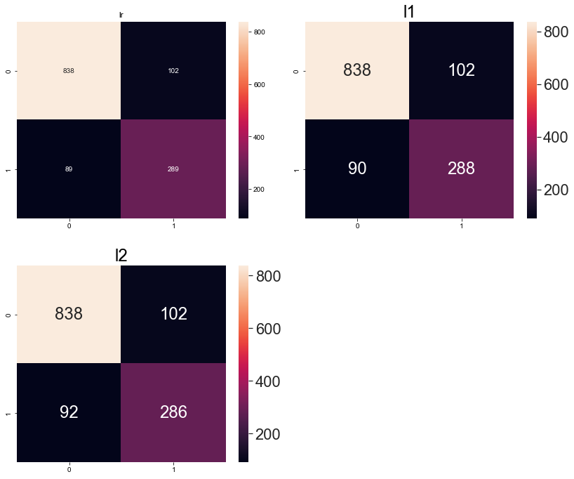
Supporting content
In order to create less complex model we turned L1 and L2 Regularzation. Although it changed the confusion matrix, it wasn't a significant one.
The key difference between these techniques is that L1 shrinks the less important feature’s coefficient to zero thus, removing some feature altogether.
This works well for feature selection in case we have a huge number of features.

Slide 22
K-Nearest Neighbor(KNN)
Kinlay Denning

Slide 23
Supporting content
Heading
Heading
List item
List item
List item
List item
List item
List item

Slide 24
Data observations

Slide 25

SVC
Denise Demirkol

Slide 26
Tensar Flow (Deep Learning)
Deepa Nair

Slide 27
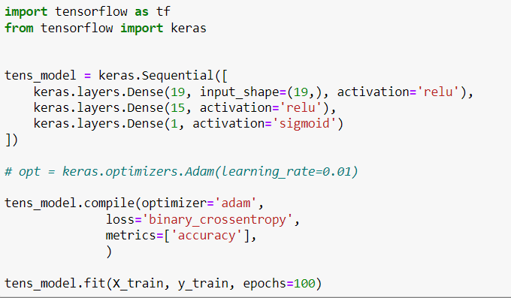
TensorFlow is an open-source library developed by Google primarily for deep learning applications

Slide 28
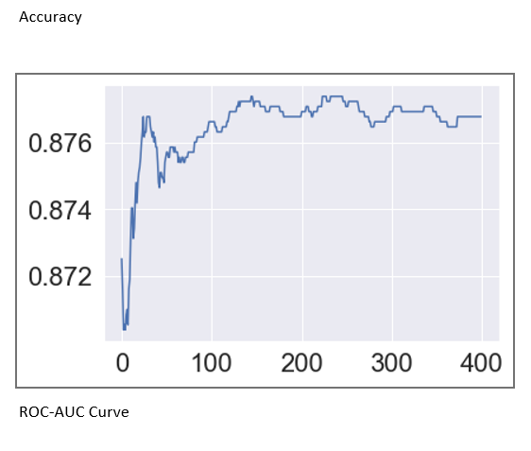
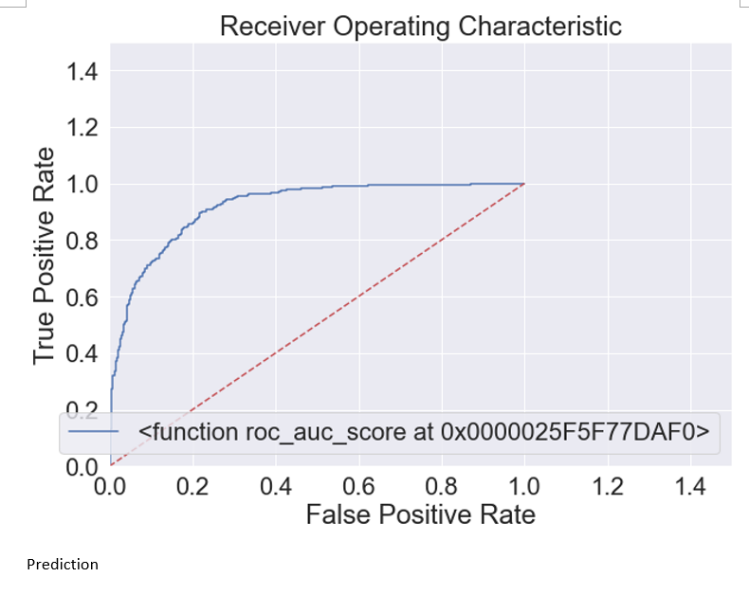
Graphs

Slide 29
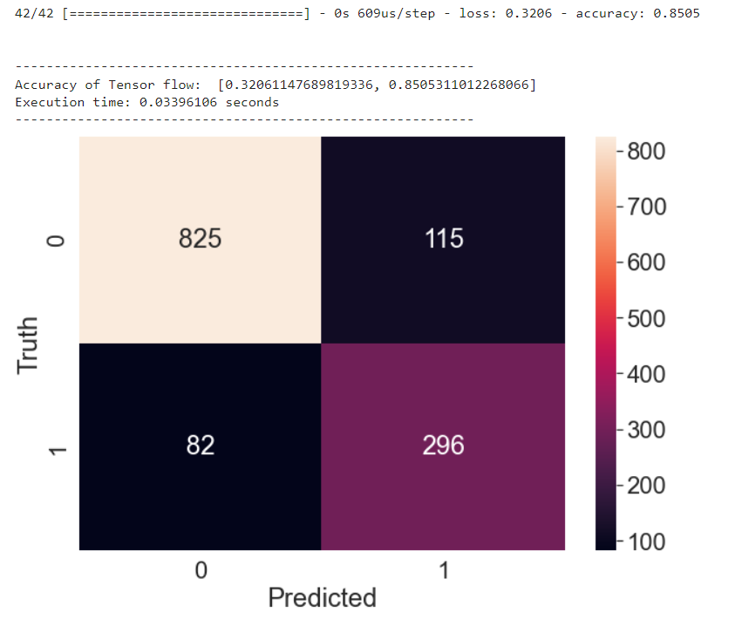
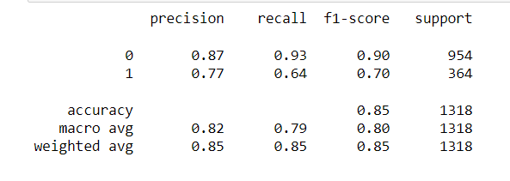
Results

Slide 30
Project Summary
Optional statement

Slide 31
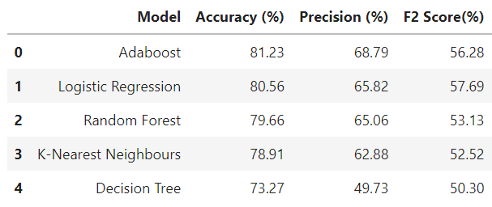
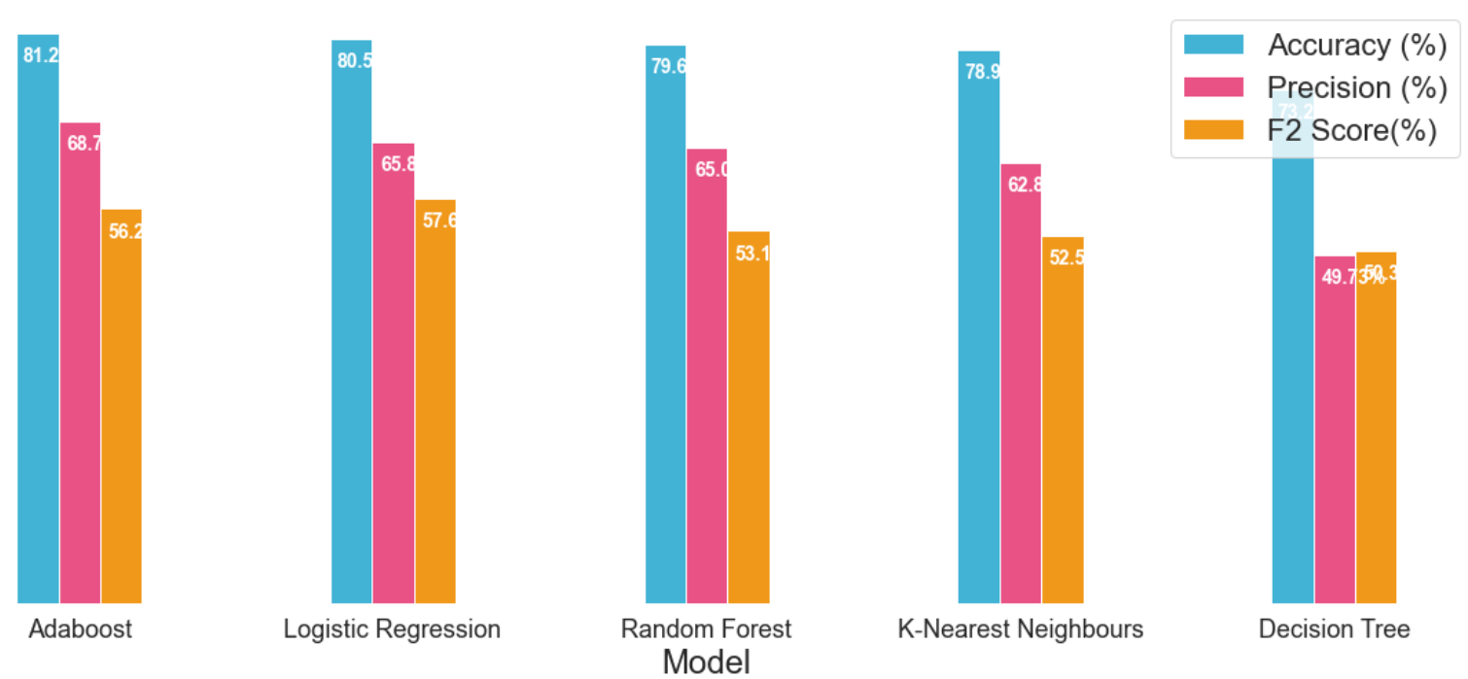
Conclusion
In this project, we have walked through a complete end-to-end machine learning project using the Telecom customer Churn dataset. We started by cleaning the data and analyzing it with visualization. Then, to be able to build a machine learning model, we transformed the categorical data into numeric variables (feature engineering). After transforming the data, we tried 6 different machine learning algorithms (including Deep Learning) using default parameters. Finally, we tuned the hyperparameters of the Adaboost (best performance model) for model optimization, obtaining an accuracy of nearly 81%.

Slide 32
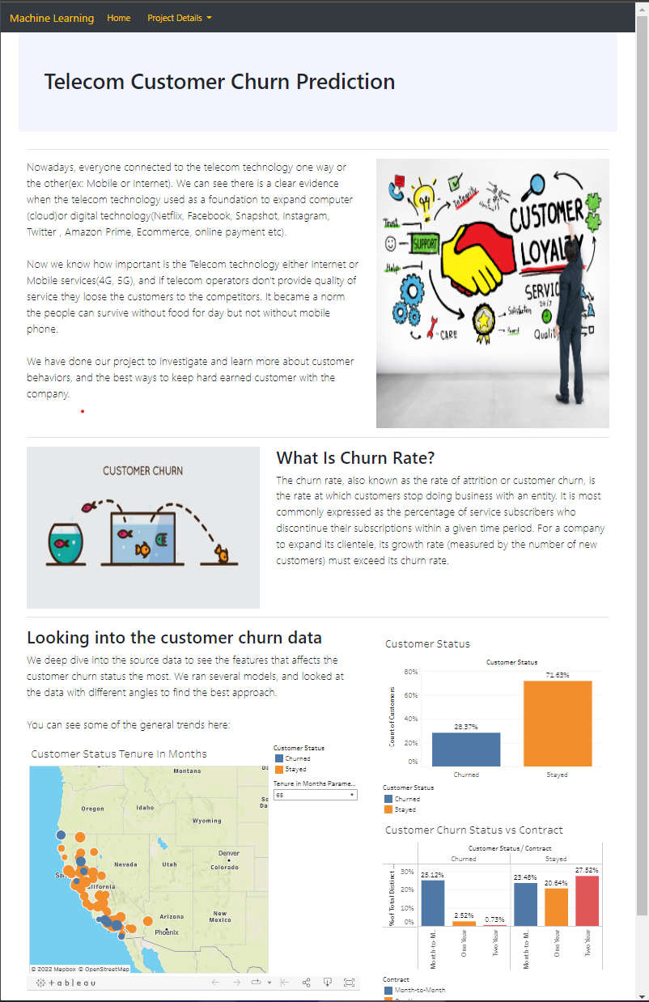
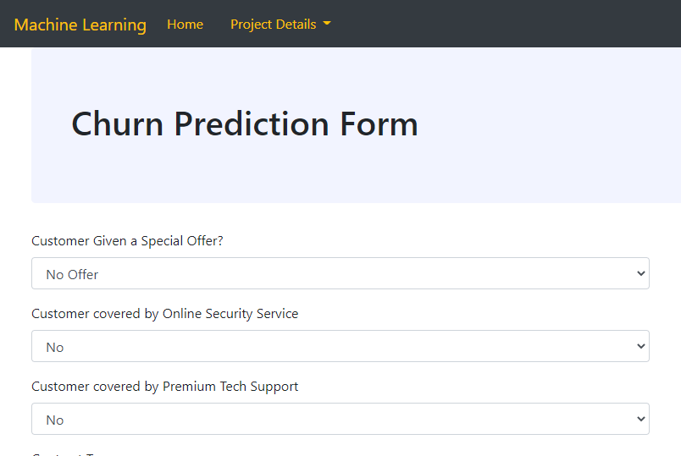
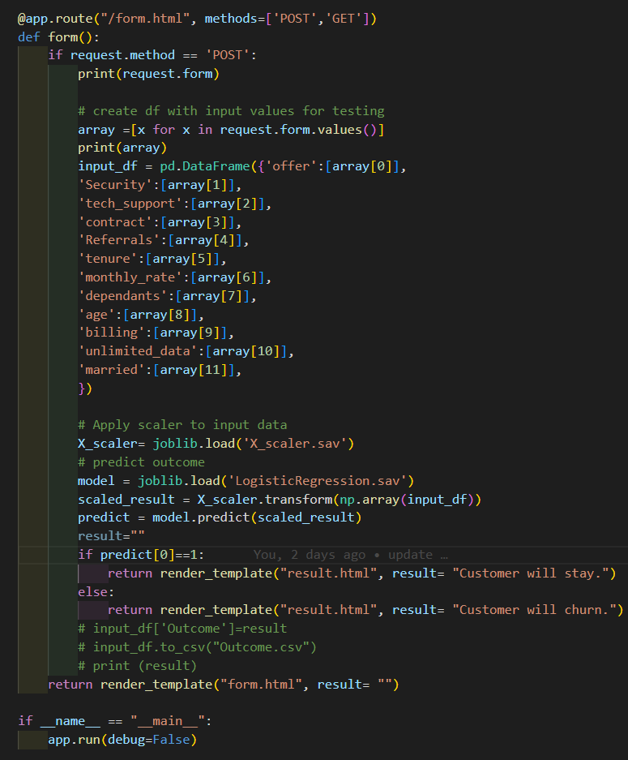
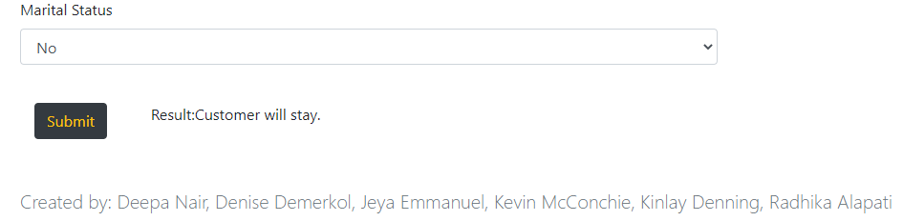
The APP

Slide 33

Questions

